Slide 1














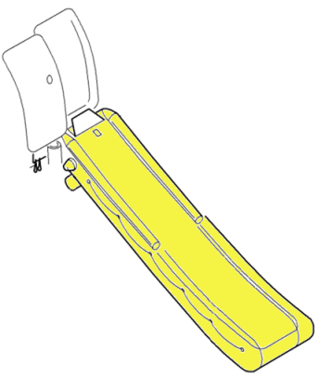
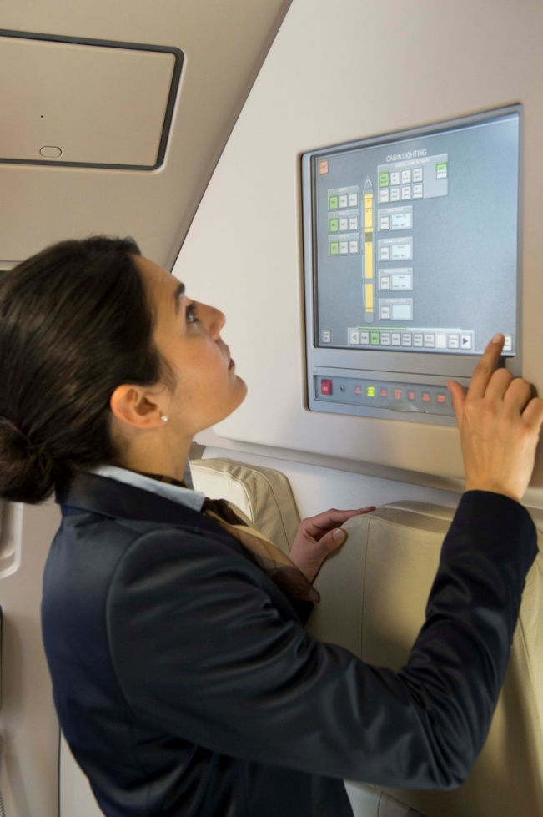



Sequence 1 => seats + IFE
$ 229,400
includes
B/C seats 64000$ + AVOD 9600 + 4 OHVD 36000 + ispss 2800
159Y/C -25000 + 8 OHVD 72000 + 159 Audio 70000
TOTAL seats
167
229,400$
1
3
5
0
+
8
2
159
4
A
A
AVOD
IFE
IFE
A
A
A
Cabin Enablers
Cabin Attendant Seat (CAS)
4
6
Handrail lighting
Slides
Pivoting bins
CDIS
Cabin Intercommunication Data System
Emergency Escape Path Marking System (EEPMS)
WCD SFE + Wifi
In red all the sections where we decide that it will not be possible to interact in this 1st MVP. So we need to validate the information included inside. Do you validate, the content above?
In green all the contents where we will be able to interact with it. For each part with the star 1,2,3…, we need to fill in the following template with the content in the select box + informations (integrating image, text (description, advantage, marketing…)

Slide 2
Star 1
Select Informations |  |  |  | 1st Overview
Kind of selection | Name of the option | Price | Categories (ex: standard, confort…) | Name of the image | Title | Description /Marketing (Limited to 200 characters)
Quantitity | Business Class seats (BFE) | 8000$ per seat | N/A | Seat_First.jpg | Large choice of BFE B/C seats | The B/C mechanical business class seat offers a variety of comfort features. Passengers will experience a comfortable flight thanks to generous recline and an oversized headrest.
Yes/No/TBD | AVOD | 1200$ per seat | N/A | Avod.png | Define your own level of service | AVOD by Airbus is the most advanced IFE system architecture. It’s a proven solution that offers unmatched performance and reliability. Provides high-value media content capacity and the ability to offer Audio Video on Demand (AVOD) at every seat, the system ensures that every passenger will enjoy an immersive and entertaining experience while onboard the aircraft.
Yes/No/TBD | In-seat Audio | 440$ per seat | N/A | In_Seat_Audio.jpg | Define your own level of service | In-seat Audio by Airbus is the most advanced IFE system architecture. It’s a proven solution that offers unmatched performance and reliability. Provides high-value media content capacity and the ability to offer In-seat Audio at every seat, the system ensures that every passenger will enjoy an immersive and entertaining experience while onboard the aircraft.
Quantity | Over Head video | 9000$ per seat | N/A | Overhead_video.jpg | Define your own level of service | Overhead video by Airbus is the most advanced IFE system architecture. Its modular design can simultaneously support overhead, in-seat distributed and on-demand content distribution on a single aircraft. This approach accommodates maximum fleet commonality, installation flexibility and future upgrade potential.
Yes/No/TBD | In Seat Power | 360$ per seat | N/A | In_Sear_power.jpg | Define your own level of service | In Seat Power by Airbus is one of the most technologically advanced aircraft in-seat power and cabin power management systems. The product is designed to guarantee airline passengers sufficient power to use their personal electronic devices, including laptops, smartphones and tablets, while in flight.
Yes/No/TBD | Class Divider | 29000$ | N/A | Windscreen.jpg | A cabin tailored to your needs | More space for the passengers Privacy for the crew Working area secured

Slide 3
Star 2
Select Informations |  |  |  | 1st Overview
Kind of selection | Name of the option | Price | Categories (ex: standard, confort…) | Name of the image | Title | Description /Marketing (Limited to 200 characters)
Quantitity: 164 | Eco Class seats (BFE) | 5000$ per seat | Select 1 of these 2 | Seat_second.jpg | Large choice of BFE B/C seats | Large choice of BFE E/C seats. You can have access to all the information thanks to our seats catalogue
Quantity | Eco Class Seats (SFE) | 2515$ per seat |  | SFE_seat.jpg Page 105 pour la suite | RECARO 3530Swift The Airbus SFE Seat Offer | Secure a seat solution for all customers, as alternative to BFE catalogue options: whatever the fleet size in line fit and retrofit with short ordering lead-time (CDF in line fit, 4 months in retrofit) Provide a “fast track” & simplified full SFE customisation solution on Single Aisle, in combination with SFE galleys: no more ITCM, PDR, CDR RECARO selected as SFE seat supplier for their product quality and delivery / in-service performance
Yes/No/TBD | AVOD | 1200$ per seat | N/A | Avod.png | Define your own level of service | AVOD by Airbus is the most advanced IFE system architecture. It’s a proven solution that offers unmatched performance and reliability. Provides high-value media content capacity and the ability to offer Audio Video on Demand (AVOD) at every seat, the system ensures that every passenger will enjoy an immersive and entertaining experience while onboard the aircraft.
Yes/No/TBD | In-seat Audio | 440$ per seat | N/A | In_Seat_Audio.jpg | Define your own level of service | In-seat Audio by Airbus is the most advanced IFE system architecture. It’s a proven solution that offers unmatched performance and reliability. Provides high-value media content capacity and the ability to offer In-seat Audio at every seat, the system ensures that every passenger will enjoy an immersive and entertaining experience while onboard the aircraft.
Quantity | Over Head video | 9000$ per seat | N/A | Overhead_video.jpg | Define your own level of service | Overhead video by Airbus is the most advanced IFE system architecture. Its modular design can simultaneously support overhead, in-seat distributed and on-demand content distribution on a single aircraft. This approach accommodates maximum fleet commonality, installation flexibility and future upgrade potential.
Yes/No/TBD | In Seat Power | 360$ per seat | N/A | In_Sear_power.jpg | Define your own level of service | In Seat Power by Airbus is one of the most technologically advanced aircraft in-seat power and cabin power management systems. The product is designed to guarantee airline passengers sufficient power to use their personal electronic devices, including laptops, smartphones and tablets, while in flight.

Slide 4
Star 3
Select Informationsv |  |  |  | 1st Overview
Kind of selection | Name of the option | Price | Categories (ex: standard, confort…) | Name of the image | Title | Description /Marketing (Limited to 200 characters)
Yes/No/TBD | WindScreen | 29000$ | N/A | Windscreen.jpg | A cabin tailored to your needs | More space for the passengers Privacy for the crew Working area secured
Yes/No/TBD | Lavatory | 153900$ | Standard | Lavatory.jpg | Hygienic and Convenient | The toilet segment boasts state-of-the-art are design and intelligent functionality with different levels of categories from standard to efficient.
 |  | 163900$ | Comfort | Lavatory.jpg | Hygienic and Convenient | The toilet segment boasts state-of-the-art are design and intelligent functionality with different levels of categories from standard to efficient.
 |  | 1888900$ | Efficient | Lavatory.jpg | Hygienic and Convenient | The toilet segment boasts state-of-the-art are design and intelligent functionality with different levels of categories from standard to efficient.
Yes/No/TBD | Galley G3, dry, 3 HS trolleys |  | Standard | Galley3_Dry_HS.png | Customized your galley and Improve your categories | The SFE galley is equipped with the following items: Monolingual placards 1 single bumper 3 stowage compartments
 |  |  | Comfort | Galley3_Dry_HS.png | Customized your galley and Improve your categories | The SFE galley is equipped with the following items: Monolingual placards 1 single bumper 3 stowage compartments
 |  |  | Efficient | Galley3_Dry_HS.png | Customized your galley and Improve your categories | The SFE galley is equipped with the following items: Monolingual placards 1 single bumper 3 stowage compartments
Yes/No/TBD | Galley G3, dry, 3 FS trolleys |  | Standard | Galley3_Dry_FS.jpg | Customized your galley and Improve your categories | The SFE galley is equipped with the following items: Monolingual placards 1 single bumper 3 stowage compartments 1 pull out device for double deep standard unit partments
 |  |  | Comfort | Galley3_Dry_FS.jpg | Customized your galley and Improve your categories | The SFE galley is equipped with the following items: Monolingual placards 1 single bumper 3 stowage compartments 1 pull out device for double deep standard unit partments
 |  |  | Efficient | Galley3_Dry_FS.jpg | Customized your galley and Improve your categories | The SFE galley is equipped with the following items: Monolingual placards 1 single bumper 3 stowage compartments 1 pull out device for double deep standard unit partments
Yes/No/TBD | Galley G3, wet, 3 FS trolleys |  | Standard | Galley3_Wet_FS.jpg | Customized your galley and Improve your categories | The SFE galley is equipped with the following items: Monolingual placards Cold weather supply water insulation 1 single bumper 1 fresh air gasper in work area 2 stowage compartments 1 pull out device for double deep standard unit partments 1 electrical panel
 |  |  | Comfort | Galley3_Wet_FS.jpg | Customized your galley and Improve your categories | The SFE galley is equipped with the following items: Monolingual placards Cold weather supply water insulation 1 single bumper 1 fresh air gasper in work area 2 stowage compartments 1 pull out device for double deep standard unit partments 1 electrical panel
 |  |  | Efficient | Galley3_Wet_FS.jpg | Customized your galley and Improve your categories | The SFE galley is equipped with the following items: Monolingual placards Cold weather supply water insulation 1 single bumper 1 fresh air gasper in work area 2 stowage compartments 1 pull out device for double deep standard unit partments 1 electrical panel

Slide 5
Star 4
Select Informations |  |  |  | 1st Overview
Kind of selection | Name of the option | Price | Categories (ex: standard, confort…) | Name of the image | Title | Description /Marketing (Limited to 200 characters)
Yes/No/TBD | Windscreen | 29000$ | N/A | Windscreen.jpg | A cabin tailored to your needs | More space for the passengers Privacy for the crew Working area secured
Yes/No/TBD | Lavatory | 153900$ | Standard | Lavatory.jpg | Hygienic and Convenient | The toilet segment boasts state-of-the-art are design and intelligent functionality with different levels of categories from standard to efficient.
 |  | 163900$ | Comfort | Lavatory.jpg | Hygienic and Convenient | The toilet segment boasts state-of-the-art are design and intelligent functionality with different levels of categories from standard to efficient.
 |  | 1888900$ | Efficient | Lavatory.jpg | Hygienic and Convenient | The toilet segment boasts state-of-the-art are design and intelligent functionality with different levels of categories from standard to efficient.
Yes/No/TBD | Stowage | 44400$ | N/A | Stowage.jpg | Optimize your space | Range of stowage solutions from hidden dog boxes, to full length wardrobes, to optimise the space on your aircraft.

Slide 6
Star 5
Select Informations |  |  |  | 1st Overview
Kind of selection | Name of the option | Price | Categories (ex: standard, confort…) | Name of the image | Title | Description /Marketing (Limited to 200 characters)
Yes/No/TBD | Lavatory | 153900$ | Standard | Lavatory.jpg | Hygienic and Convenient | The toilet segment boasts state-of-the-art are design and intelligent functionality with different levels of categories from standard to efficient.
 |  | 163900$ | Comfort | Lavatory.jpg | Hygienic and Convenient | The toilet segment boasts state-of-the-art are design and intelligent functionality with different levels of categories from standard to efficient.
 |  | 1888900$ | Efficient | Lavatory.jpg | Hygienic and Convenient | The toilet segment boasts state-of-the-art are design and intelligent functionality with different levels of categories from standard to efficient.
Yes/No/TBD | Galley G4, 4FS | 70000$ | Standard
 |  | 85000$ | Comfort
 |  | 114800$ | Efficient
Yes/No/TBD | Galley G5 7 FS Trolleys | 122500$ | Standard | Galley_G5.jpg
 |  | 137500$ | Comfort | Galley_G5_Comfort.jpg
 |  | 167300$ | Efficient | Galley_G5_Efficient.jpg
Yes/No/TBD | Space-Flex lavatory module | 307800$ | Standard | Space_Flex_Lavatory.jpg | Free up space for additional seats
 |  | 327800$ | Comfort | Space_Flex_Lavatory.jpg | Free up space for additional seats
 |  | 377800$ | Efficient | Space_Flex_Lavatory.jpg | Free up space for additional seats
Yes/No/TBD | Galley G4a, Space FLEX Galley | 70000$ | Standard |  | Free up space for additional seats
 |  | 85000$ | Comfort |  | Free up space for additional seats | Premium galley design with further provisions for a high number of additional options. Flexibility to provision for or to install multiple galley cooling options.
 |  | 114800$ | Efficient |  | Free up space for additional seats | Basic design and options to provide simple, efficient and practical solutions. Weight optimised galley.

Slide 7
Star 6
Select Informations |  |  |  | 1st Overview
Kind of selection | Name of the option | Price | Categories (ex: standard, confort…) | Name of the image | Title | Description /Marketing (Limited to 200 characters)
Yes/No/TDB | Mood-lighting | 74100$ | N/A | Moodlight.jpg | Making magic out of light | 16.7 million shades of colors For customized ambiances & well-being
Yes/No/TBD | Floor mounted EEPMS | 19300$ | N/A | Floor_light | A cabin tailored to your needs | the latest next-generation emergency exit lighting solution helping to save significant costs, both operational and maintenance -
Yes/No/TBD | OHSC Handrail | 88500$ | N/A | OHSC_Handrail.jpg | Light as a consistent branding message | Handrail branding can remain, even when lights are dimmed

Slide 8
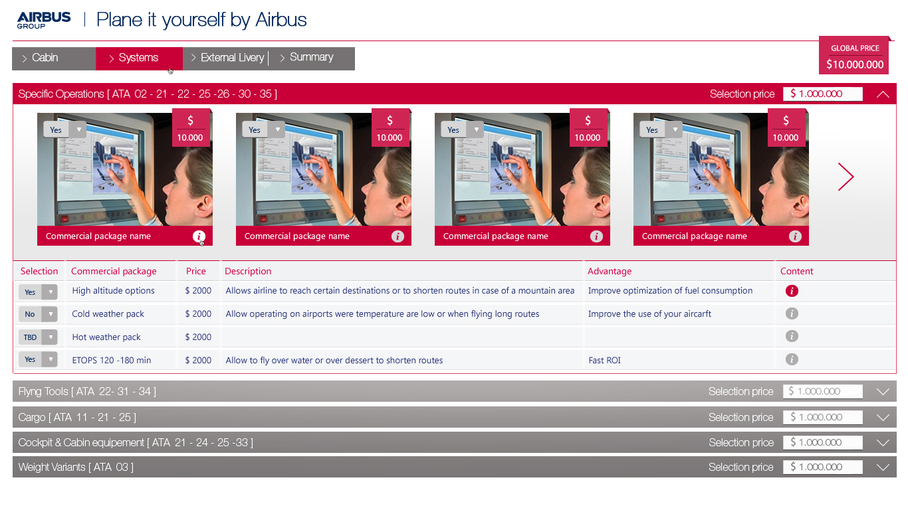

Slide 9

Add a new categories before Cabin
Add space between external livery and summary
Weight Variant
✗
✗
✓
✗
✓
Text to be provided
✗
✗
✗
✗
✗
✗

Slide 10
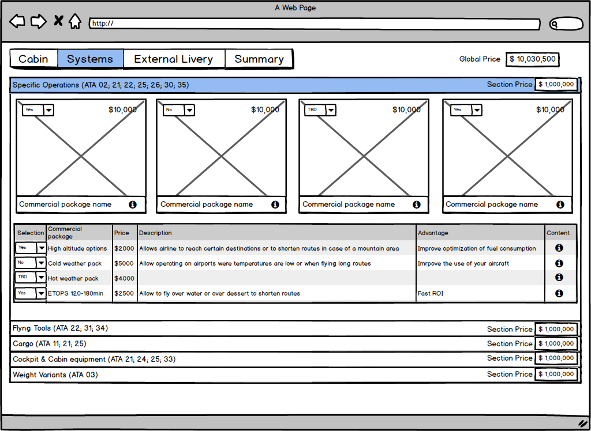
Image associated to this commercial package + Contents
Image associated to this commercial package
Image associated to this commercial package
Image associated to this commercial package
Commercial package name
Commercial package name
Commercial package name
Commercial package name
Confirm the contents commercial package + Content of Information for the first line: Table next slide

Slide 11
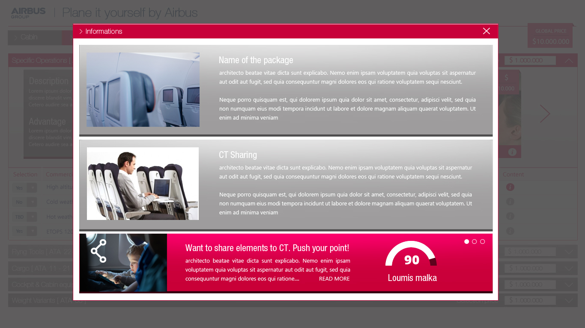

Slide 12
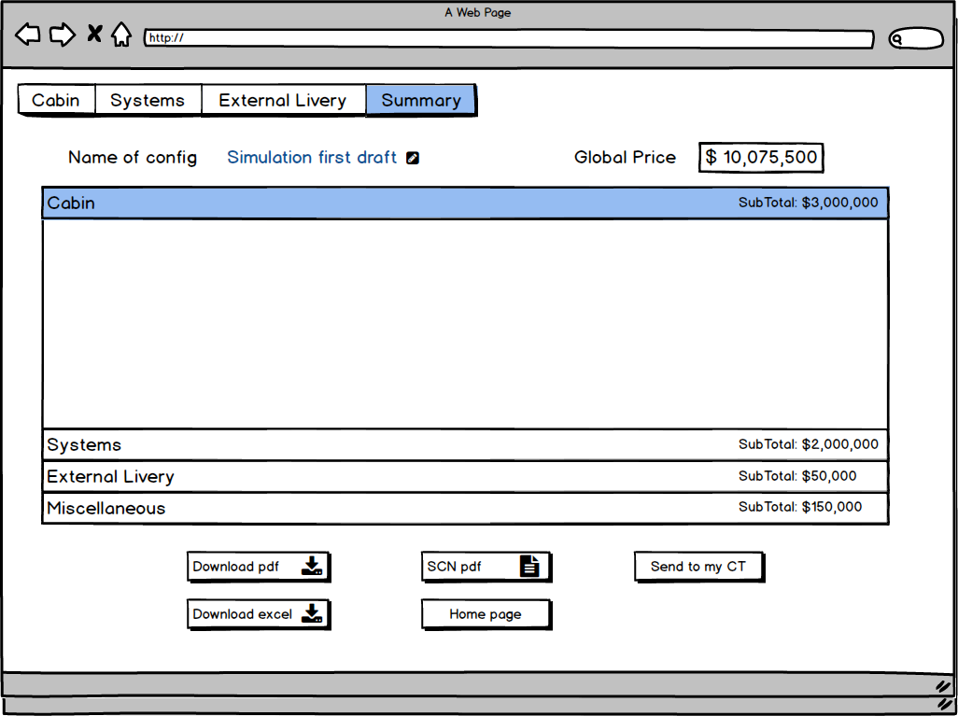
Information in the each category of Summary
Name of the commercial package – categories (standard, confort…) – Number - Price

